Slide 1
Deep Learning
3. Computer Vision Tasks
Term 4, 2025
Skoltech

Slide 2
Outline
A short recap of a previous lecture
Classification evaluation metrics
Edge detection task
Image enhancement evaluation metrics
Denoising and super-resolution task
Segmentation evaluation metrics
Semantic segmentation task
Bounding box detection task
Instance and panoptic segmentation tasks

Slide 3
A short recap of a previous lecture
History of CNN development for an image classification task
First layer extracts features
Middle layers are the body of CNN
The last linear layer(s) is the classification head
Model input is an image
Model output is a vector with NCLASS elements
Each value in a vector is a confidence
Top-1 value is the predicted class of the input image

Slide 4
Edge Detection Task
Mark every pixel as an edge or not an edge
Binary classification problem for every pixel
Need to learn quality metrics for classification at first
Top-1, Top-K accuracy
Precision
Recall
F1 score
AP (Average Precision)
mAP (mean Average Precision)

Slide 5
Classification Evaluation Metrics
Basic terms:
There are several objects
We want to categorize them (e.g., define a class for every object)
Some problem setups allow multiclass labeling
For every object there is a vector of values
Each value is a confidence, that a given object belongs to a given class
There might be several such vectors (due to multiclass labeling)
We may select not a single, but several largest confidence values per vector
In this case a guess is correct, if true class is one of the chosen classes

Slide 6
Classification Evaluation Metrics
Top-1 Accuracy: percentage of objects where the top predicted class matches the true class
If a model predicts:
Image 1: "cat" (true: "cat") → Correct
Image 2: "dog" (true: "cat") → Incorrect
Image 3: "bird" (true: "bird") → Correct
Then:
Top-1 Accuracy = 2/3 = 66.7%
Top-K Accuracy: percentage of objects where the top K predicted classes contain the true class
It is just a single value

Slide 7
Classification Evaluation Metrics
For every class, the following metrics can be computed:
True Positive (TP): Correctly identified instances (e.g., correctly detected cats)
False Positive (FP): Incorrectly identified instances (e.g., non-cats detected as cats)
False Negative (FN): Missed instances (e.g., actual cats that were not detected)
True Negative (TN): Correctly rejected instances (e.g., correctly identified non-cats)
Confusion Matrix | Predicted + | Predicted -
Actual + | TP | FN
Actual - | FP | TN

Slide 8
Classification Evaluation Metrics
Precision (P): the ratio of correctly identified positive instances to all instances identified as positive
P = TP / (TP + FP)
P@K means our guess contains K classes for every object
Minimum is 0
Maximum is 1
The more, the better
A vector with number of classes values
Confusion Matrix | Predicted + | Predicted -
Actual + | TP | FN
Actual - | FP | TN

Slide 9
Classification Evaluation Metrics
Precision (P): the ratio of correctly identified positive instances to all instances identified as positive
P = TP / (TP + FP)
If a model detects 100 edges and 80 of them are actual edges, then:
TP = 80 (correctly detected edges)
FP = 20 (non-edges detected as edges)
P = 80 / (80 + 20) = 0.8 or 80%
Confusion Matrix | Predicted + | Predicted -
Actual + | TP | FN
Actual - | FP | TN

Slide 10
Classification Evaluation Metrics
Recall (R): the ratio of correctly identified positive instances to all actual positive instances
R = TP / (TP + FN)
R@K means our guess contains K classes for every object
Minimum is 0
Maximum is 1
The more, the better
A vector with number of classes values
Confusion Matrix | Predicted + | Predicted -
Actual + | TP | FN
Actual - | FP | TN

Slide 11
Classification Evaluation Metrics
Recall (R): the ratio of correctly identified positive instances to all actual positive instances
R = TP / (TP + FN)
If there are 100 actual edges in an image and the model detects 70 of them:
TP = 70 (correctly detected edges)
FN = 30 (missed edges)
R = 70 / (70 + 30) = 0.7 or 70%
Confusion Matrix | Predicted + | Predicted -
Actual + | TP | FN
Actual - | FP | TN

Slide 12
Classification Evaluation Metrics
F1-score: harmonic mean of precision and recall, providing a balanced measure of a model's performance
F1 = 2 * (precision * recall) / (precision + recall)
F1@K means our guess contains K classes for every object
Minimum is 0
Maximum is 1
The more, the better
A vector with number of classes values
Confusion Matrix | Predicted + | Predicted -
Actual + | TP | FN
Actual - | FP | TN

Slide 13
Classification Evaluation Metrics
F1-score: harmonic mean of precision and recall, providing a balanced measure of a model's performance
F1 = 2 * (precision * recall) / (precision + recall)
Using the previous examples:
precision = 0.8
recall = 0.7
F1 = 2 * (0.8 * 0.7) / (0.8 + 0.7) = 0.74666
Confusion Matrix | Predicted + | Predicted -
Actual + | TP | FN
Actual - | FP | TN

Slide 14
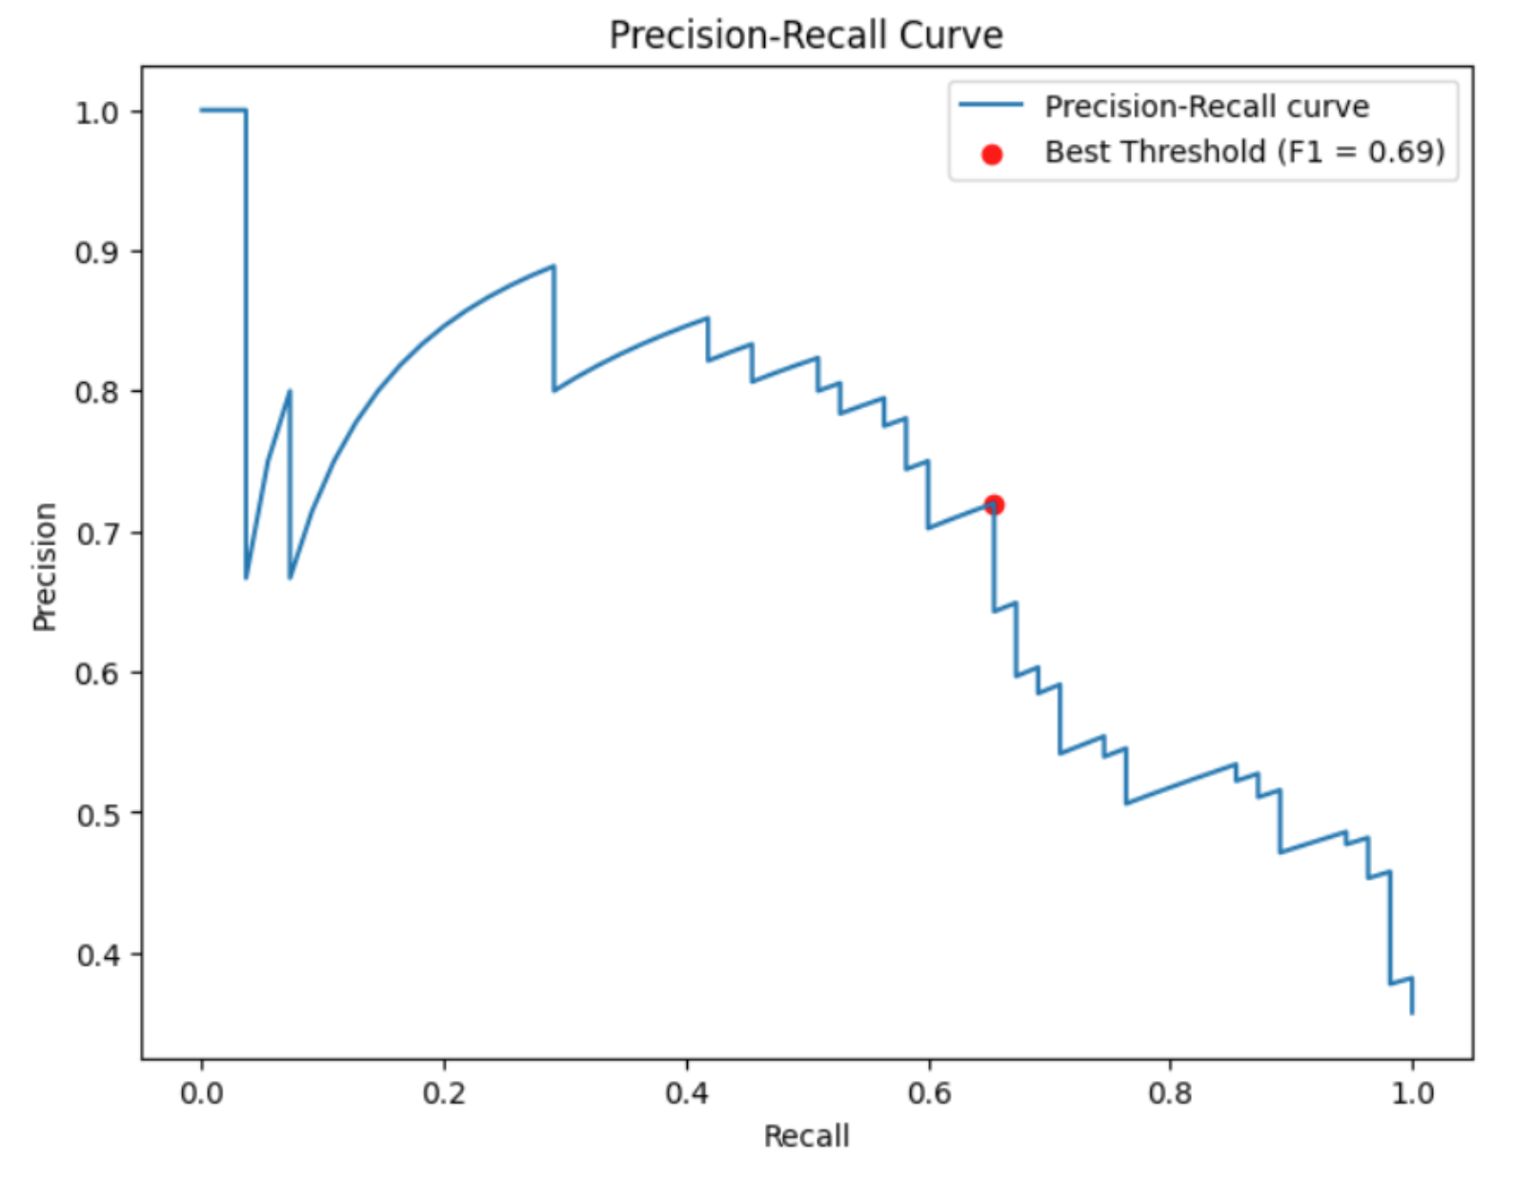
Classification Evaluation Metrics
Recall levels: different confidence thresholds for classification
As threshold decreases:
More detections (higher recall)
Generally, more false positives (lower precision)
As threshold increases:
Fewer detections (lower recall)
Generally, more accurate detections (higher precision)
Confidence threshold acts similar to labeling in a top-K style
https://www.blog.trainindata.com/precision-recall-curves/

Slide 15
Classification Evaluation Metrics
AP: average precision
It is not an average of a precision over all classes!
It is an area under a Precision-Recall curve (average over all possible recalls)
How to calculate:
Sort detections by confidence score
Calculate precision and recall at each confidence threshold
Plot precision-recall curve
Calculate area under the curve (AUC)
https://www.blog.trainindata.com/precision-recall-curves/

Slide 16
Classification Evaluation Metrics
AP: average precision
It is not an average of a precision over all classes!
It is an area under a Precision-Recall curve (average over all possible recalls)
How to calculate:
Sort detections by confidence score
Calculate precision and recall at each confidence threshold
Plot precision-recall curve
Calculate area under the curve (AUC)
Detection| Confidence | TP/FP
-------------|----------------|---------
Edge | 0.95 | TP
Edge | 0.90 | TP
Edge | 0.85 | FP
Edge | 0.80 | TP
Edge | 0.75 | FP
Edge | 0.70 | TP

Slide 17
Classification Evaluation Metrics
AP: average precision
It is not an average of a precision over all classes!
It is an area under a Precision-Recall curve (average over all possible recalls)
How to calculate:
Sort detections by confidence score
Calculate precision and recall at each confidence threshold
Plot precision-recall curve
Calculate area under the curve (AUC)
Threshold|TP|FP|Precision|Recall
-------------|----|---|------------|-------
0.95 | 1 | 0 | 1.0 | 0.1
0.90 | 2 | 0 | 1.0 | 0.2
0.85 | 2 | 1 | 0.67 | 0.2
0.80 | 3 | 1 | 0.75 | 0.3
0.75 | 3 | 2 | 0.60 | 0.3
0.70 | 4 | 2 | 0.67 | 0.4

Slide 18
Classification Evaluation Metrics
Precision
1.0 | •
| / \
| / \
| / \
| / \
| / \
|/ \
0.0 +------------------+ Recall
0.0 1.0
AP: average precision
It is not an average of a precision over all classes!
It is an area under a Precision-Recall curve (average over all possible recalls)
How to calculate:
Sort detections by confidence score
Calculate precision and recall at each confidence threshold
Plot precision-recall curve
Calculate area under the curve (AUC)

Slide 19
Classification Evaluation Metrics
mAP (Mean Average Precision): average precision across all classes
For object detection with 2 classes:
Class "Cat":
AP = 0.75
Class "Dog":
AP = 0.85
mAP = (0.75 + 0.85) / 2 = 0.80

Slide 20
Edge Detection Task
Edge detection: identifying points in an image where brightness changes sharply or has discontinuities
Edge detection: per-pixel classification problem
CNN approaches:
HED (Holistically-Nested Edge Detection) (2015)
RCF (Richer Convolutional Features) (2017)
Method | F1-Score on BSD500 Dataset
Canny | 0.61
HED | 0.79
RCF | 0.81

Slide 21
Edge Detection Task
HED (Holistically-Nested Edge Detection) (2015)
Key Innovations:
First to use deep learning for edge detection
Combines multi-scale and multi-level features through side outputs
Uses a weighted fusion layer to combine predictions from different scales
Architecture:
VGG-16 backbone with side outputs after each stage
Each side output produces an edge map
Final fusion layer combines all side outputs
Training: Uses a weighted cross-entropy loss for each side output
https://arxiv.org/abs/1504.06375

Slide 22
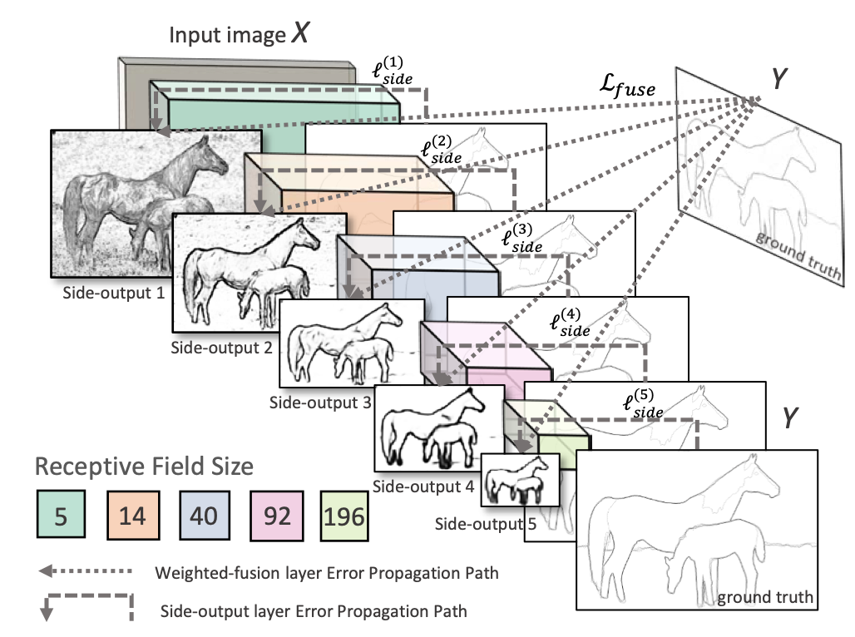
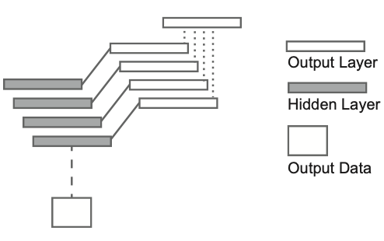
Edge Detection Task
HED (Holistically-Nested Edge Detection) (2015)
https://arxiv.org/abs/1504.06375
https://arxiv.org/abs/1504.06375

Slide 23
Edge Detection Task
RCF (Richer Convolutional Features) (2017)
Key Innovations:
Uses all convolutional features in the network, not just the last layer in a stage
Introduces a fusion strategy that preserves more detailed information
Better handles multi-scale edge detection
More robust to different edge types and scales
Architecture:
VGG-16 backbone with feature fusion at multiple levels
Combines features from all convolutional layers
Uses a hierarchical feature fusion strategy
Training: Uses a balanced loss function to handle edge/non-edge class imbalance
https://arxiv.org/abs/1612.02103

Slide 24
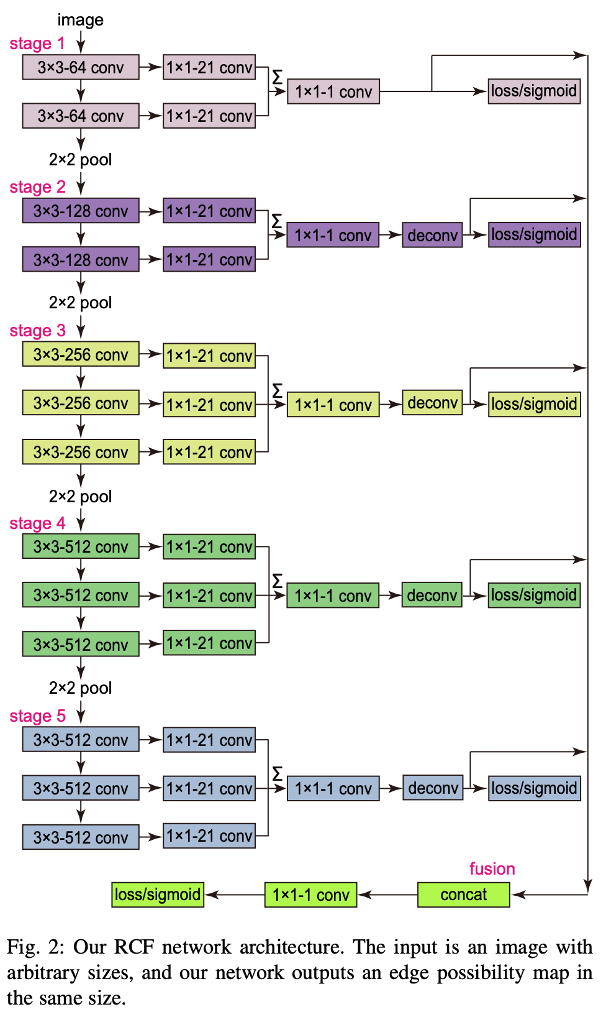
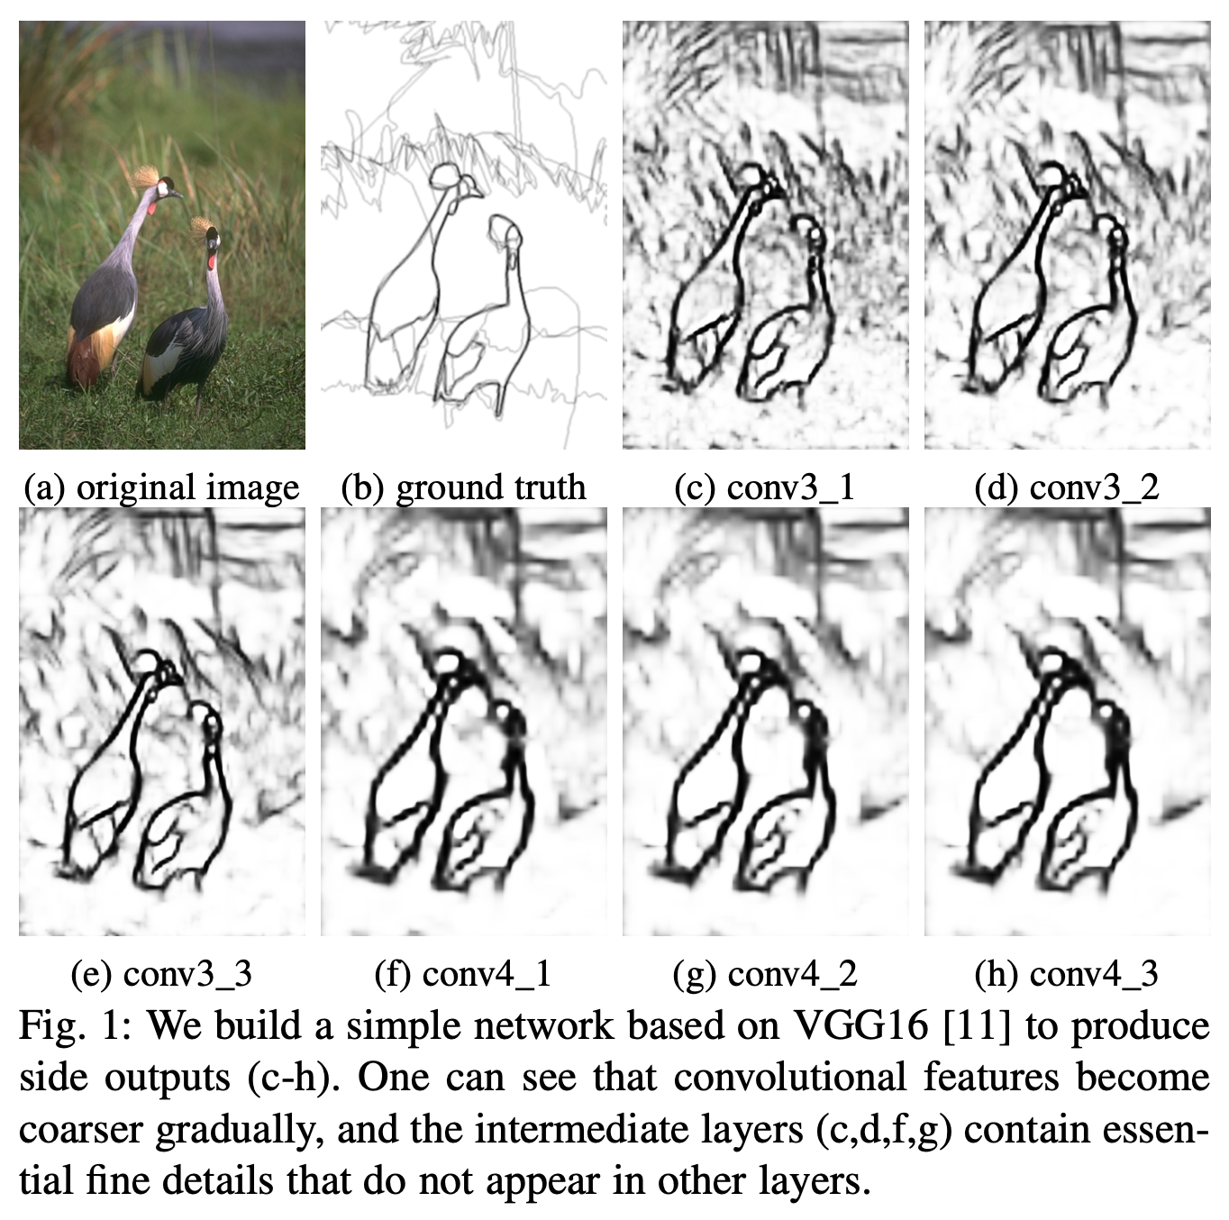
Edge Detection Task
RCF (Richer Convolutional Features) (2017)
https://arxiv.org/abs/1612.02103
https://arxiv.org/abs/1612.02103

Slide 25
Edge Detection Task
Datasets
BSDS500 (Berkeley Segmentation Data Set and Benchmarks)
500 natural images
Multiple human-annotated ground truth segmentations
Contains both edge and region annotations
https://www2.eecs.berkeley.edu/Research/Projects/CS/vision/grouping/resources.html
NYUDv2 (NYU Depth Dataset V2)
1449 RGB-D images
Includes depth information
Useful for studying edge detection with depth cues
https://cs.nyu.edu/~silberman/datasets/nyu_depth_v2.html

Slide 26
Edge Detection Task
Data augmentation
Geometric Transformations
Rotation, Scaling, Flipping (horizontal/vertical)
Perspective transforms
Photometric Transformations
Brightness, contrast adjustment
Color jittering
Gaussian noise addition
Synthetic Edge Generation
Add synthetic edges with known ground truth
Vary edge thickness and intensity
Create edge patterns

Slide 27
Denoising Task
Find out per-pixel noise and subtract it from the original image
Need to learn quality metrics for image denoising at first
PSNR
SSIM

Slide 28
Image Enhancement Evaluation Metrics
PSNR (Peak Signal-to-Noise Ratio): ratio between the maximum possible power of a signal and the power of corrupting noise
PSNR = 20 * log10(MAX_I) - 10 * log10(MSE)
MAX_I = maximum possible pixel value (usually 255)
MSE = mean squared error between original and processed image
For an 8-bit image (MAX_I = 255):
If MSE = 100
PSNR = 20 * log10(255) - 10 * log10(100) ≈ 48.13 - 20 = 28.13 dB
Interpretation:
Higher PSNR = better quality
PSNR > 30 dB: Good quality
PSNR < 20 dB: Poor quality

Slide 29
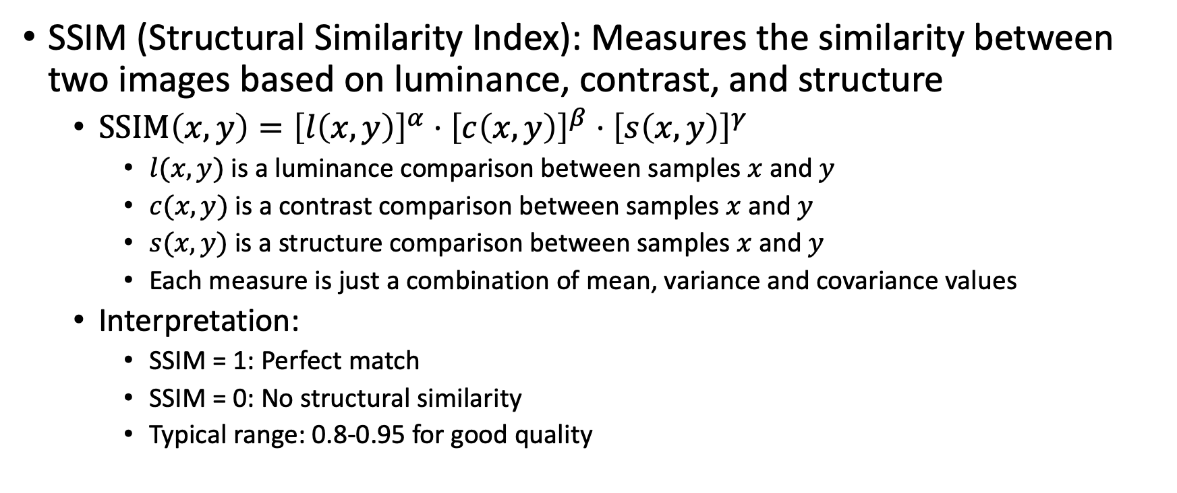
Image Enhancement Evaluation Metrics
SSIM (Structural Similarity Index): Measures the similarity between two images based on luminance, contrast, and structure
$SSIM\left(x,y\right)={\left[l\left(x,y\right)\right]}^{α}⋅{\left[c\left(x,y\right)\right]}^{β}⋅{\left[s\left(x,y\right)\right]}^{γ}$
$l(x,y)$ is a luminance comparison between samples $x$ and $y$
$c(x,y)$ is a contrast comparison between samples $x$ and $y$
$s(x,y)$ is a structure comparison between samples $x$ and $y$
Each measure is just a combination of mean, variance and covariance values
Interpretation:
SSIM = 1: Perfect match
SSIM = 0: No structural similarity
Typical range: 0.8-0.95 for good quality

Slide 30
Denoising Task
Image denoising: removing noise from an image while preserving important features
CNN approaches:
DnCNN (Denoising Convolutional Neural Networks) (2017)
FFDNet (Fast and Flexible denoising network) (2018)

Slide 31
Denoising Task
DnCNN (Denoising Convolutional Neural Networks) (2017)
Key Innovations:
Introduces residual learning to predict noise instead of clean image
Handles different noise levels with a single model
Uses batch normalization and ReLU for better training
Architecture:
17-layer CNN with residual connections
Uses batch normalization after each convolution
Outputs noise map which is subtracted from input
Training: uses mean squared error loss on noise maps
https://arxiv.org/abs/1608.03981

Slide 32
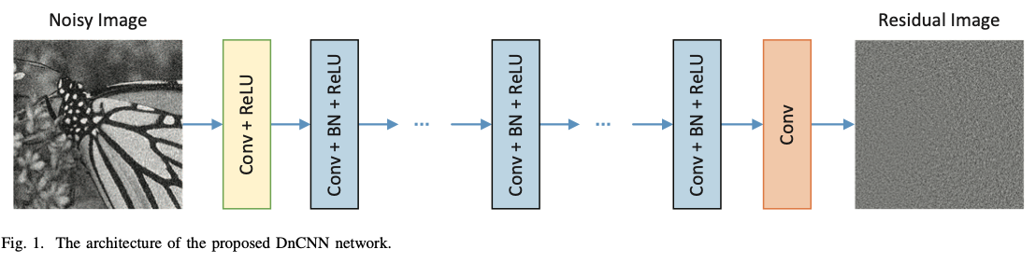
Denoising Task
DnCNN (Denoising Convolutional Neural Networks) (2017)
https://arxiv.org/abs/1608.03981

Slide 33
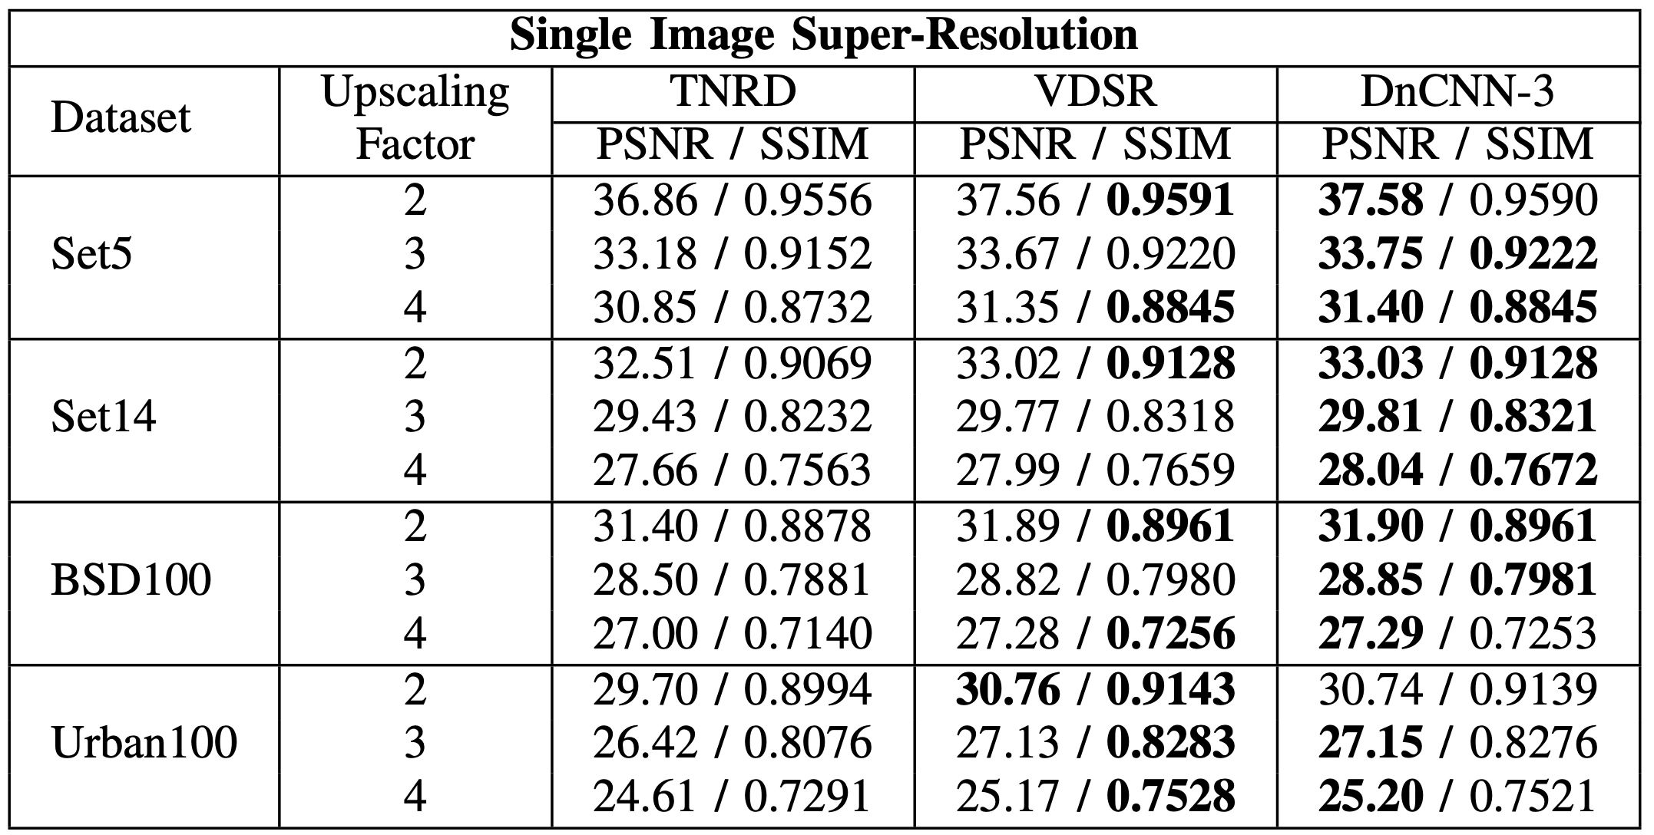
Denoising Task
DnCNN (Denoising Convolutional Neural Networks) (2017)
https://arxiv.org/abs/1608.03981

Slide 34
Denoising Task
FFDNet (Fast and Flexible denoising network) (2018)
Key Innovations:
First to use noise level map as input
Can handle spatially variant noise
More flexible than previous methods
Faster inference time
Architecture:
Takes both noisy image and noise level map as input
Uses downsampling and upsampling for efficiency
Processes noise level map through separate branches
Training: uses noise level map to guide denoising process
https://arxiv.org/abs/1710.04026

Slide 35
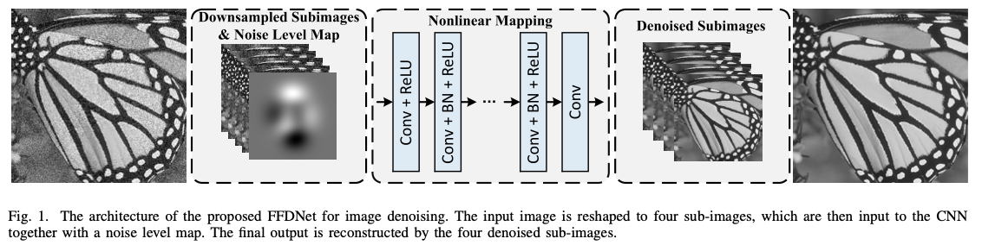
Denoising Task
FFDNet (Fast and Flexible denoising network) (2018)
https://arxiv.org/abs/1710.04026

Slide 36
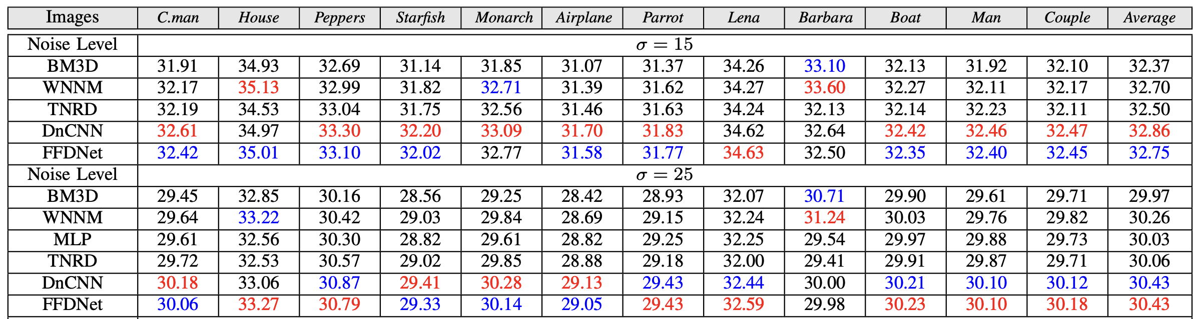
Denoising Task
FFDNet (Fast and Flexible denoising network) (2018)
PSNR comparison against other approaches:
https://arxiv.org/abs/1710.04026

Slide 37
Denoising Task
Datasets
DIV2K
1000 high-quality RGB images
Used for both denoising and super-resolution
Includes various noise levels
https://data.vision.ee.ethz.ch/cvl/DIV2K/
SIDD (Smartphone Image Denoising Dataset)
Real noisy images from smartphones
Paired clean images
Different lighting conditions and scenes
https://www.eecs.yorku.ca/~kamel/sidd/

Slide 38
Denoising Task
Data augmentation
Noise Generation
Different noise types, including mixes
Noise Level Variation
Different noise levels for same image
Progressive noise addition
Noise pattern variation
Image Processing
Blur addition
JPEG compression artifacts
Sensor noise simulation

Slide 39
Super-Resolution Task
Image super-resolution: increasing the resolution of an image while preserving or enhancing its quality
CNN approach:
SRCNN (Super-Resolution CNN) (2014)
Other neural networks:
ESRGAN (Enhanced Super-Resolution GAN) (2018)
RCAN (Residual Channel Attention Network) (2018)

Slide 40
Super-Resolution Task
SRCNN (Super-Resolution CNN) (2014)
Key Innovations:
The first CNN for super-resolution
End-to-end mapping from low to high resolution
Three-layer architecture
Learns non-linear mapping
Architecture:
Patch extraction and representation
Non-linear mapping
Reconstruction
Training: uses MSE loss
https://arxiv.org/abs/1501.00092

Slide 41
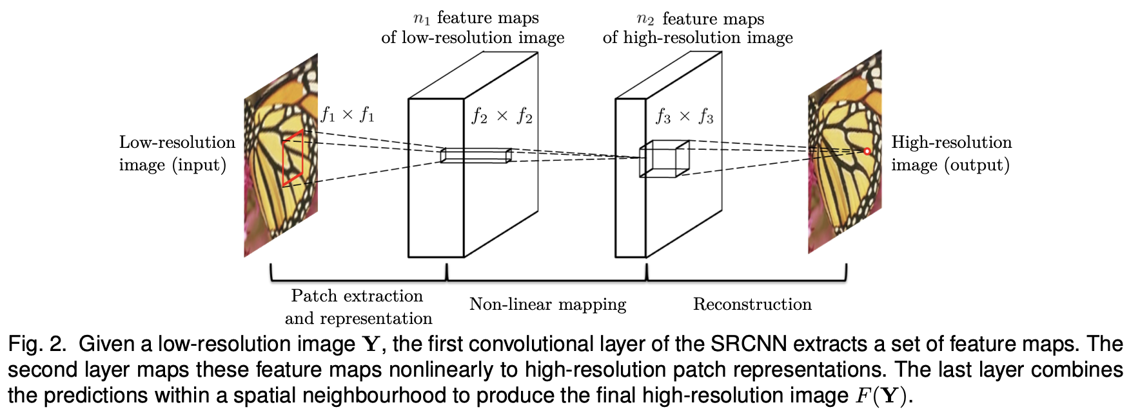
Super-Resolution Task
SRCNN (Super-Resolution CNN) (2014)
https://arxiv.org/abs/1501.00092

Slide 42
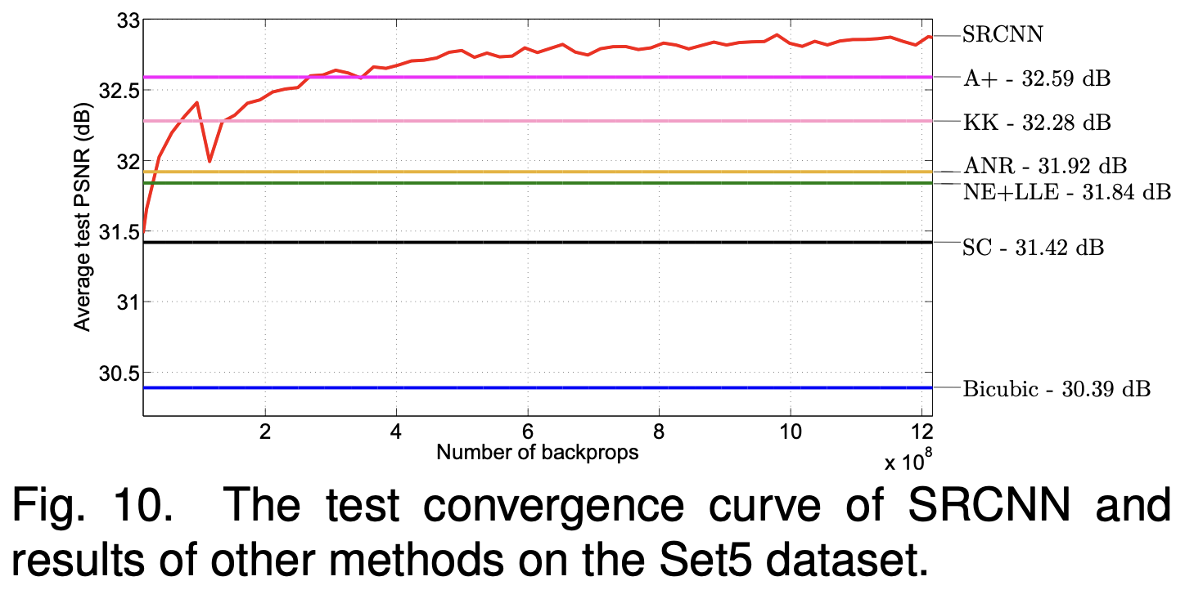
Super-Resolution Task
SRCNN (Super-Resolution CNN) (2014)
https://arxiv.org/abs/1501.00092

Slide 43
Super-Resolution Task
Datasets:
DIV2K
1000 high-quality images, various scales (2x, 3x, 4x), used for training and validation
https://data.vision.ee.ethz.ch/cvl/DIV2K/
Set5/Set14
Small test sets (5/14 images), Commonly used for benchmarking
https://huggingface.co/datasets/eugenesiow/Set5
https://huggingface.co/datasets/eugenesiow/Set14
Urban100
100 urban scene images, challenging for super-resolution, contains complex structures
https://huggingface.co/datasets/eugenesiow/Urban100

Slide 44
Super-Resolution Task
Data Augmentation for Super-Resolution:
Data augmentation approaches for image denoising
Noise addition
JPEG artifacts
Geometric transformations
Downsampling Methods
Bicubic downsampling
Gaussian blur + downsampling
Different downsampling kernels

Slide 45
Super-Resolution Task
Applications:
Medical Imaging
Enhancing medical scans
Improving diagnosis accuracy
Reducing scanning time
Satellite Imagery
Enhancing remote sensing data
Improving land use analysis
Better environmental monitoring
Video Enhancement
Upscaling old videos
Improving streaming quality
Enhancing surveillance footage
Mobile Photography
Zoom enhancement
Low-light image improvement
Better detail preservation

Slide 46
Segmentation Task
Partitioning an image into multiple segments or regions
Need to learn quality metrics for segmentation at first
IoU (Intersection over Union)
mIoU (mean Intersection over Union)

Slide 47
Segmentation Evaluation metrics
IoU (Intersection over Union): Ratio of the area of overlap to the area of union between predicted and ground truth segments
IoU = Area of Overlap / Area of Union
Ground Truth: [1 1 0] Predicted: [1 1 0] Overlap: [1 1 0] Union: [1 1 0] [1 1 0] [1 0 0] [1 0 0] [1 1 0] [0 0 0] [0 0 0] [0 0 0] [0 0 0] IoU = 3 / 4 = 0.75
Explanation:
Overlap: Pixels where both ground truth and prediction are 1
Union: Pixels where either ground truth or prediction is 1
IoU = Number of overlapping pixels / Number of pixels in union

Slide 48
Segmentation Evaluation metrics
mIoU (mean Intersection over Union): Average IoU across all classes in a segmentation task
For a 3-class segmentation (background, cat, dog):
Background IoU = 0.9
Cat IoU = 0.7
Dog IoU = 0.8
Then:
mIoU = (0.9 + 0.7 + 0.8) / 3 = 0.8

Slide 49
Segmentation Tasks
Image segmentation: partitioning an image into multiple segments or regions
Types of Segmentation:
Semantic Segmentation
Instance Segmentation
Panoptic Segmentation

Slide 50
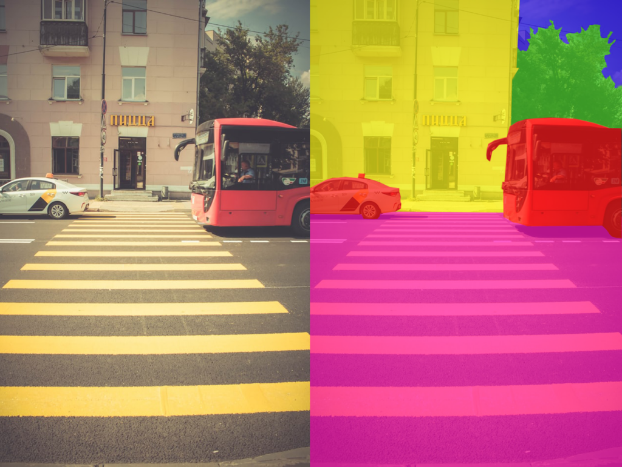
Semantic Segmentation Task
Semantic segmentation: assign a class label to each pixel
Does not distinguish between different instances of the same class
Example: All cars are labeled as "car" regardless of how many there are
CNN approaches:
FCN (Fully Convolutional Networks) (2015)
U-NET (2015)
DeepLab (2017)
https://raw.githubusercontent.com/oseledets/dl2024/8d739d06892c9cc71f198c1c478d51b4a6801866/lectures/lecture-4/semantic-seg.png

Slide 51
Semantic Segmentation Task
FCN (Fully Convolutional Networks) (2015)
Key Innovations:
First end-to-end trainable CNN for semantic segmentation
Replaces fully connected layers with convolutional layers
Introduces skip connections to combine coarse and fine features
First to achieve pixel-wise prediction
Architecture:
VGG-16 backbone with fully convolutional layers
Skip connections from early layers
Transposed convolution for upsampling
Training: Uses pixel-wise cross-entropy loss
https://arxiv.org/abs/1411.4038

Slide 52
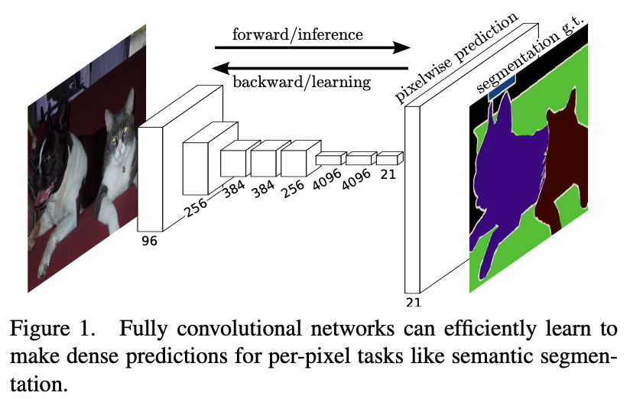
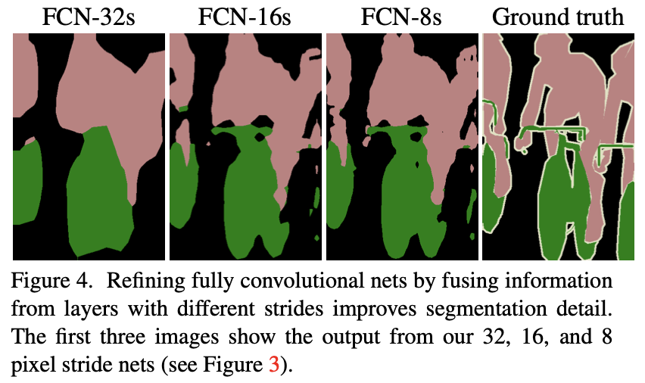
Semantic Segmentation Task
FCN (Fully Convolutional Networks) (2015)
https://arxiv.org/abs/1411.4038

Slide 53
Semantic Segmentation Task
U-Net (2015)
Key Innovations:
Symmetric encoder-decoder structure
Skip connections between encoder and decoder
Better handling of fine details
Works well with small datasets
Architecture:
Contracting path (encoder) captures context
Expanding path (decoder) enables precise localization
Skip connections combine local and global information
Training: Uses weighted cross-entropy loss for better boundary detection
https://arxiv.org/abs/1505.04597

Slide 54
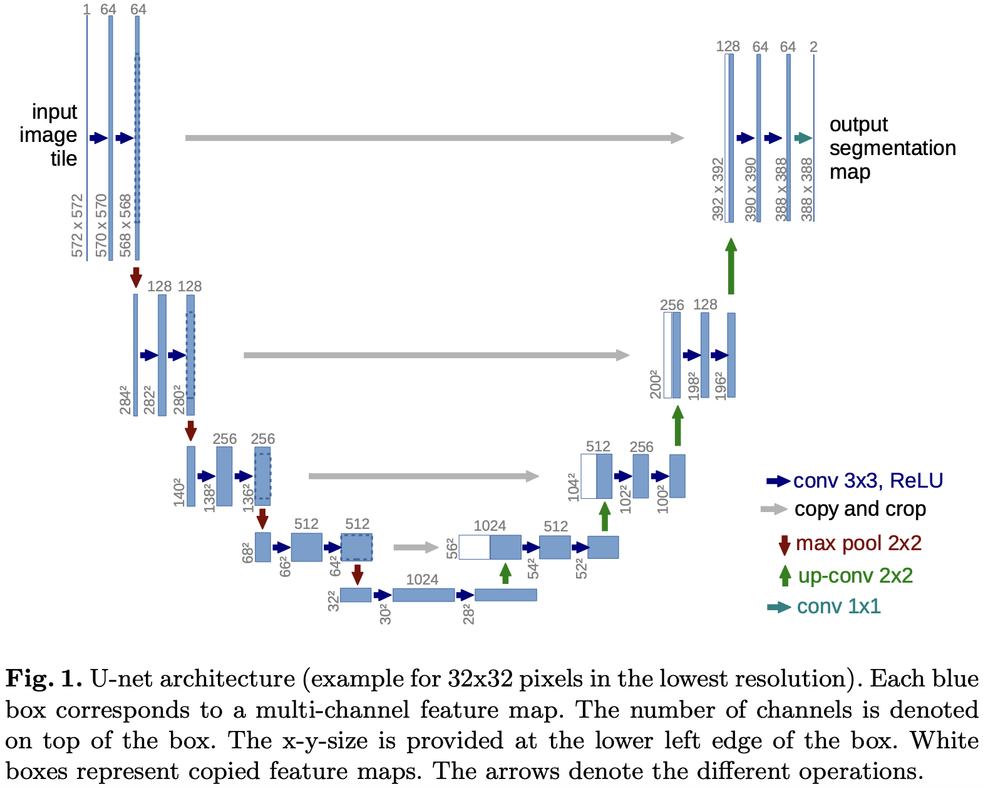
Semantic Segmentation Task
U-Net (2015)
https://arxiv.org/abs/1505.04597

Slide 55
Semantic Segmentation Task
DeepLab (2017)
Key Innovations:
Introduces atrous convolution for larger receptive field
Atrous spatial pyramid pooling (ASPP) module captures multi-scale context
Better handling of objects at different scales
Improved boundary accuracy
Architecture:
ResNet backbone with atrous convolution
ASPP module with multiple dilation rates
Conditional Random Field (CRF) post-processing for refinement
Training: Uses cross-entropy loss with auxiliary loss
https://arxiv.org/abs/1606.00915

Slide 56
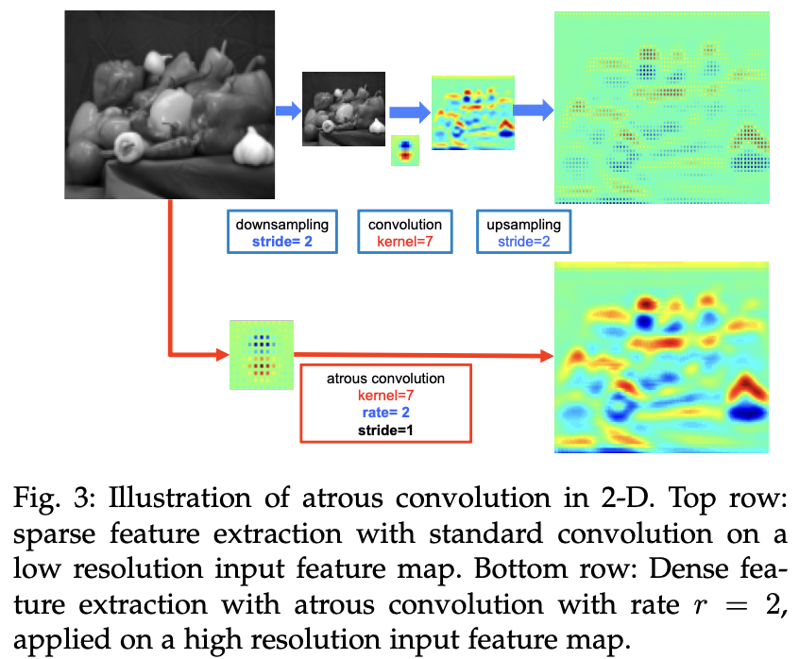
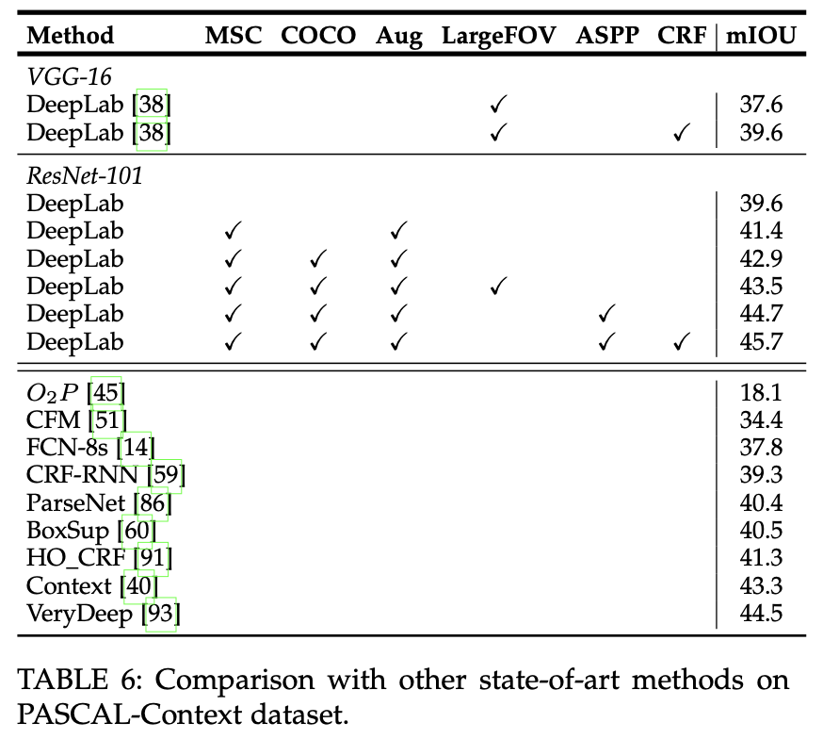
Semantic Segmentation Task
DeepLab (2017)
https://arxiv.org/abs/1606.00915

Slide 57
Semantic Segmentation Task
Datasets:
PASCAL VOC (Visual Object Classes)
20 object classes, pixel-level annotations, includes object boundaries
http://host.robots.ox.ac.uk/pascal/VOC/
Cityscapes
Urban street scenes, 30 classes, fine and coarse annotations, includes stereo images
https://www.cityscapes-dataset.com/
ADE20K
20,000 images, 150 object categories, scene parsing annotations
https://groups.csail.mit.edu/vision/datasets/ADE20K/

Slide 58
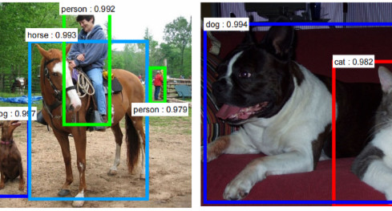
Bounding Box Detection Task
Bounding box detection: find objects by means of a rectangular bounding box with a class
CNN approaches:
R-CNN Family (2014-2017)
YOLO (2016)
SSD (2016)
https://arxiv.org/abs/1506.01497

Slide 59
Bounding Box Detection Task
R-CNN (Region-based CNN) (2014)
Key Innovations:
First CNN-based object detector
Uses selective search for region proposals
Extracts CNN features for each region
Uses SVM for classification
Linear regression for bounding box refinement
Architecture:
Region proposal generation (selective search)
CNN feature extraction (AlexNet)
SVM classification
Bounding box regression
Limitations:
Slow (processes each region separately)
Multi-stage training
https://arxiv.org/abs/1311.2524

Slide 60
Bounding Box Detection Task
Fast R-CNN (2015)
Key Innovations:
Processes entire image through CNN once
Uses RoI (Region of Interest) pooling to extract features
End-to-end training
Multi-task loss (classification + regression)
Architecture:
CNN backbone
RoI pooling layer
Classification and regression heads
Improvements:
Faster training and inference
Better accuracy
Single-stage training
https://arxiv.org/abs/1504.08083

Slide 61
Bounding Box Detection Task
Faster R-CNN (2016)
Key Innovations:
Region Proposal Network (RPN)
Anchor boxes
Shared features between RPN and detection
Architecture:
CNN backbone
RPN for region proposals
RoI pooling
Classification and regression heads
Advantages:
Real-time detection
Better accuracy
Fully convolutional
https://arxiv.org/abs/1506.01497

Slide 62
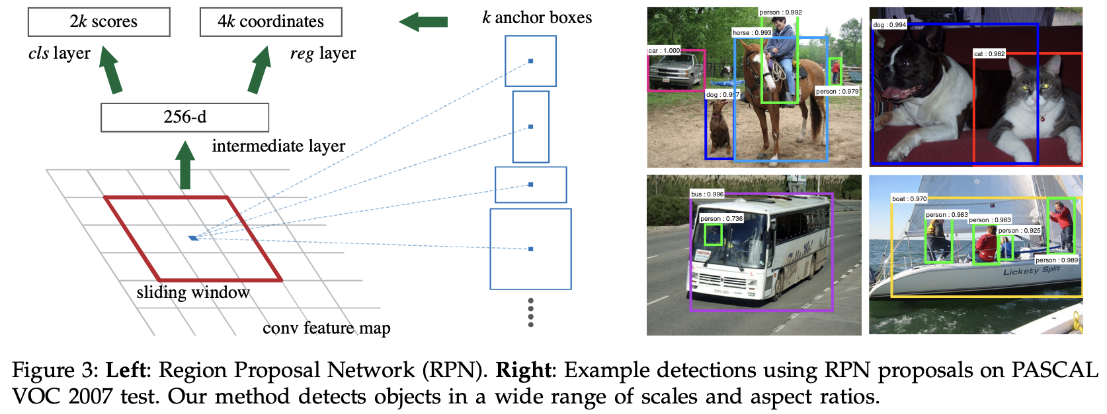
Bounding Box Detection Task
Faster R-CNN (2016)
https://arxiv.org/abs/1506.01497

Slide 63
Bounding Box Detection Task
YOLOv1 (2016)
Key Innovations:
Divides image into grid cells
Each cell predicts bounding boxes and classes
End-to-end training
Architecture:
24 convolutional layers
2 fully connected layers
Grid-based prediction
Advantages:
Very fast
Global context
Simple architecture
https://arxiv.org/abs/1506.02640

Slide 64
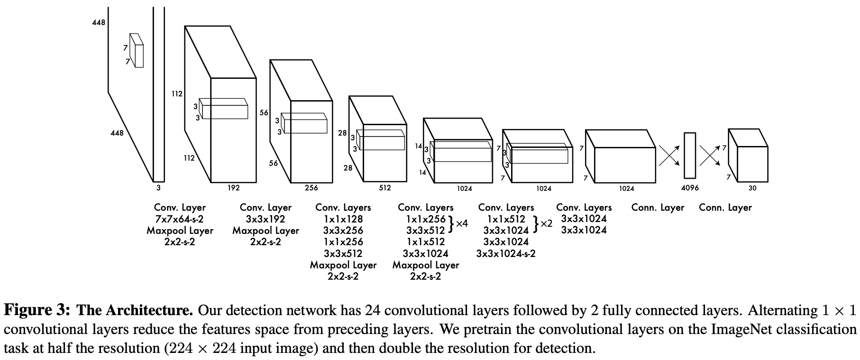
Bounding Box Detection Task
YOLOv1 (You Only Look Once) (2016)
https://arxiv.org/abs/1506.02640

Slide 65
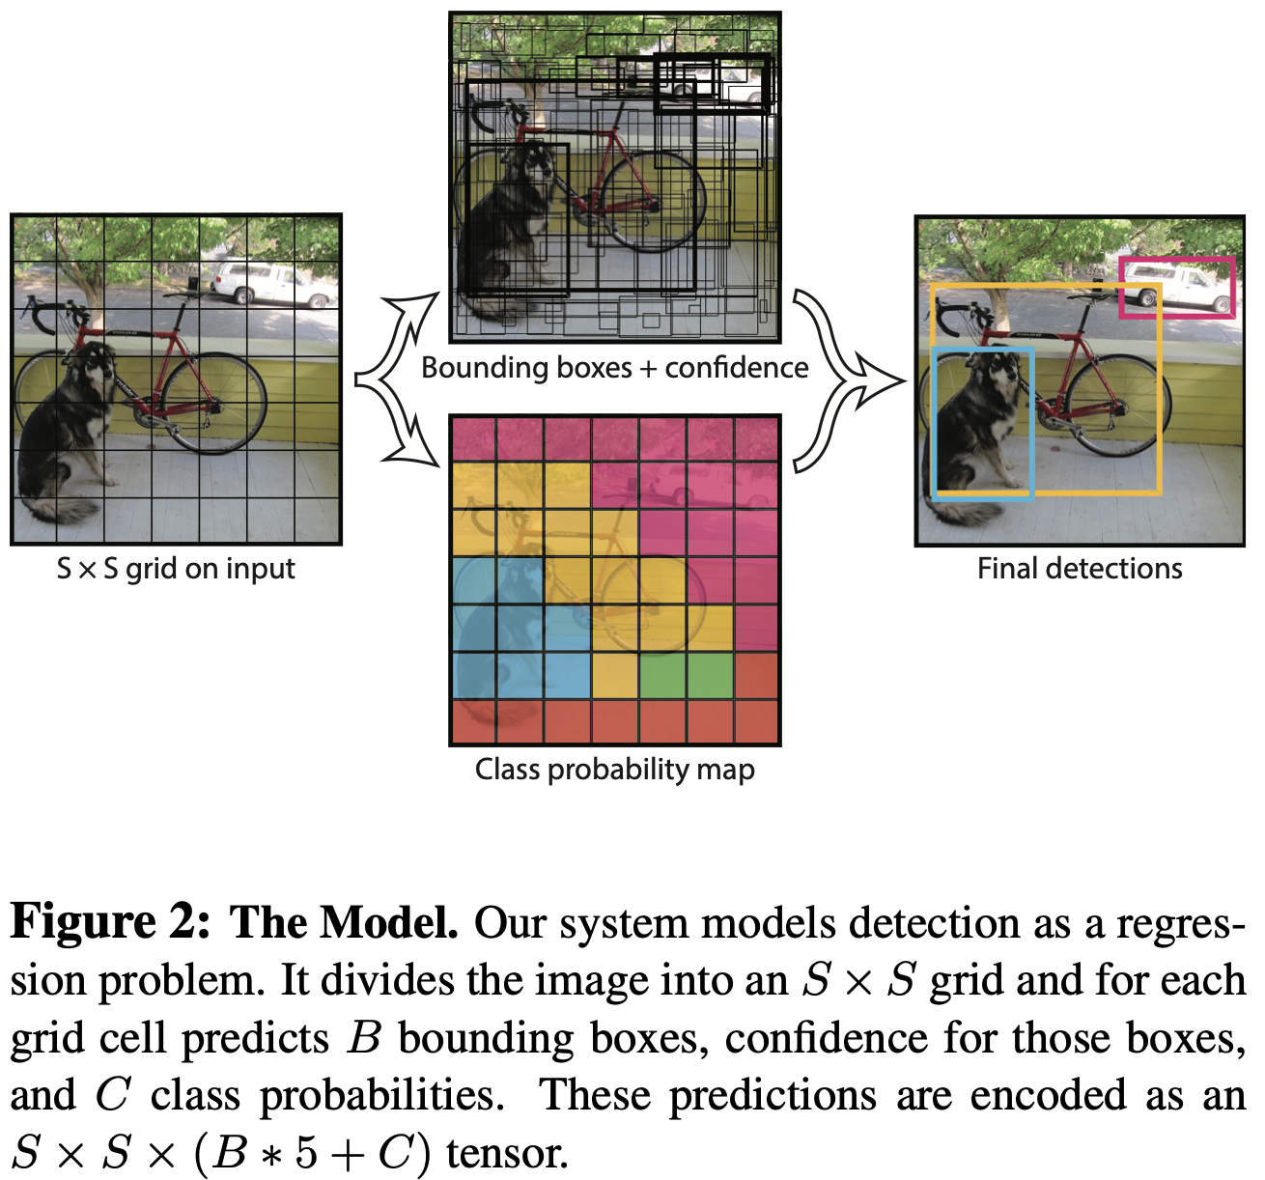
Bounding Box Detection Task
YOLOv1 (2016)
https://arxiv.org/abs/1506.02640

Slide 66
Bounding Box Detection Task
YOLOv2/YOLO9000 (2017)
Key Innovations:
Batch normalization
High resolution classifier
Anchor boxes
Multi-scale training
Architecture:
Darknet-19 backbone
Anchor box prediction
Improvements:
Better accuracy
Faster than YOLOv1
Detects 9000 classes
https://arxiv.org/abs/1612.08242

Slide 67
Bounding Box Detection Task
YOLOv3 (2018)
Key Innovations:
Feature pyramid network (we will see it in Instance Segmentation Task)
Better backbone (Darknet-53)
Binary cross-entropy loss
Architecture:
Darknet-53 backbone
Three detection scales
Feature pyramid network
Advantages:
Better small object detection
Improved accuracy
Good speed-accuracy trade-off
https://arxiv.org/abs/1804.02767

Slide 68
Bounding Box Detection Task
YOLOv4 (2020)
Key Innovations:
CSPDarknet53 backbone
PANet feature aggregation
Mosaic data augmentation
CIoU loss (to improve imbalanced datasets)
Architecture:
CSPDarknet53 backbone
SPP and PANet modules
YOLOv3 head
Improvements:
Better accuracy
Faster training
More robust
https://arxiv.org/abs/2004.10934

Slide 69
Bounding Box Detection Task
SSD (Single Shot MultiBox Detector) (2016)
Key Innovations:
Multi-scale feature maps
Default boxes (similar to anchor boxes)
Hard negative mining (takes into account negative samples incorrectly identified)
Data augmentation
Architecture:
VGG-16 backbone
Additional convolutional layers
Multi-scale prediction layers
Advantages:
Good speed-accuracy trade-off
Simple architecture
Easy to implement
https://arxiv.org/abs/1512.02325

Slide 70
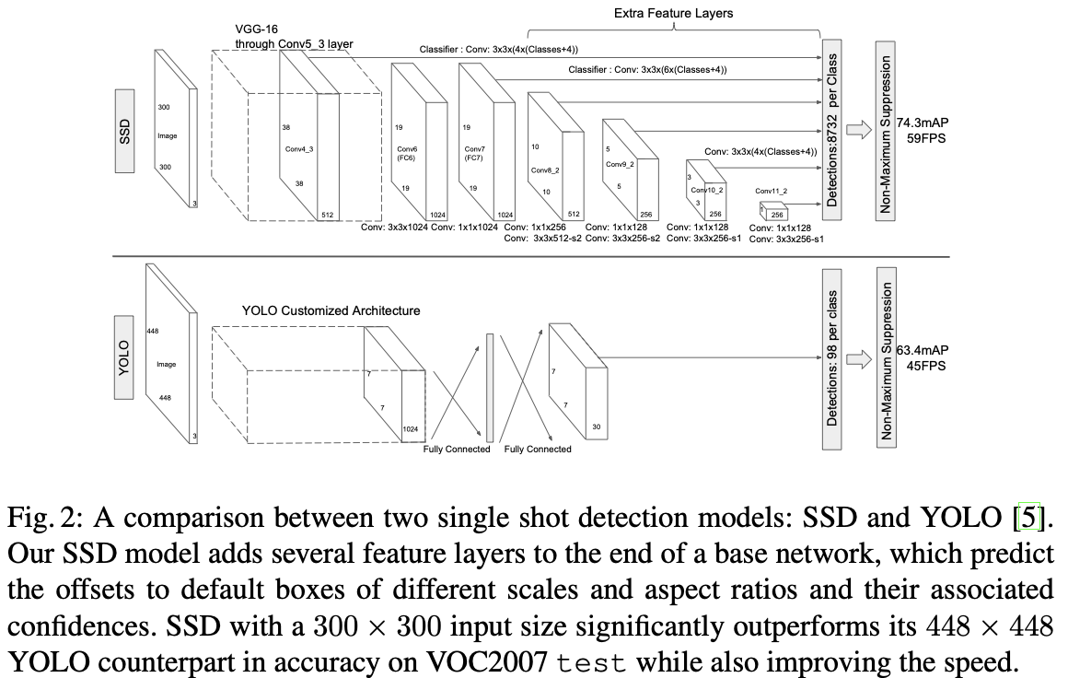
Bounding Box Detection Task
SSD (2016)
https://arxiv.org/abs/1512.02325

Slide 71
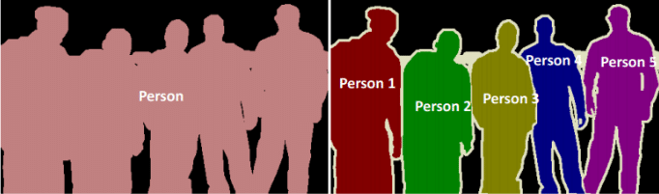
Instance Segmentation Task
Instance segmentation: identifies and segments each object instance separately
Distinguishes between different instances of the same class
Each car gets a unique label (car1, car2, etc.)
Each person gets a unique label (person1, person2, etc.)
https://raw.githubusercontent.com/oseledets/dl2024/8d739d06892c9cc71f198c1c478d51b4a6801866/lectures/lecture-4/instance.png

Slide 72
Instance Segmentation Task
Instance segmentation: identifies and segments each object instance separately
Distinguishes between different instances of the same class
Each car gets a unique label (car1, car2, etc.)
Each person gets a unique label (person1, person2, etc.)
CNN approaches:
Mask R-CNN (2017)
YOLACT (2019)

Slide 73
Instance Segmentation Task
Mask R-CNN (2017)
Approach: Extends Faster R-CNN with mask prediction branch
Key Innovations:
Adds parallel mask branch to object detection
Uses RoIAlign (RoI for Region of Interest) layer for better mask accuracy
Handles both detection and segmentation
Architecture:
ResNet and FPN (Feature Pyramid Network) backbones
Region Proposal Network (RPN)
Mask prediction branch
Training: Multi-task loss (classification, box regression, mask)
https://arxiv.org/abs/1703.06870

Slide 74
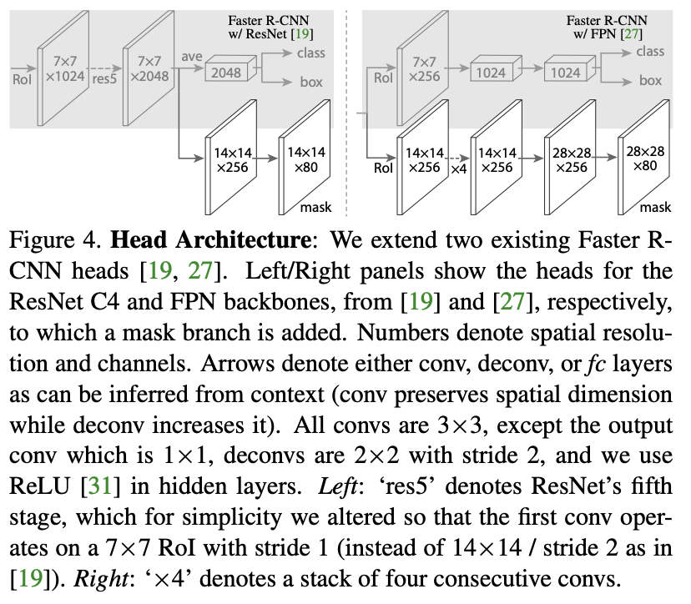
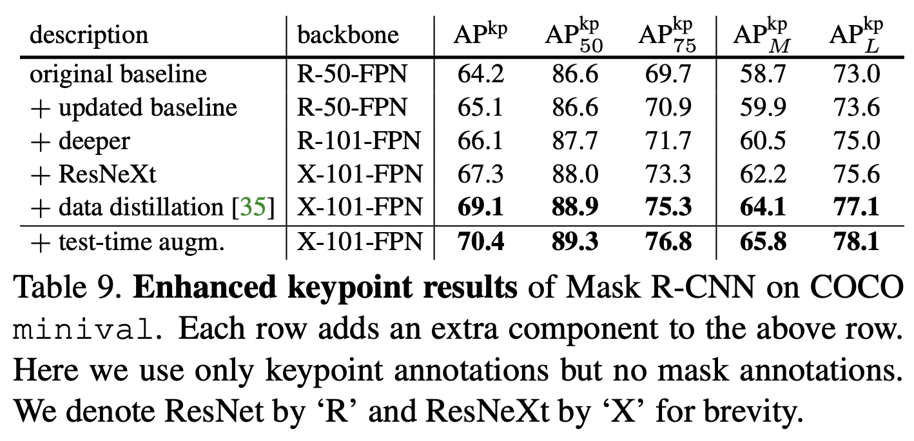
Instance Segmentation Task
Mask R-CNN (2017)
https://arxiv.org/abs/1703.06870

Slide 75
Instance Segmentation Task
YOLACT (2019)
Key Innovations:
First real-time instance segmentation model
Uses prototype masks and mask coefficients
Fast inference speed
Architecture:
Any convolutional backbone network
Prototype generation branch
Mask coefficient prediction
Training: Uses combination of classification and mask losses
https://arxiv.org/abs/1904.02689

Slide 76
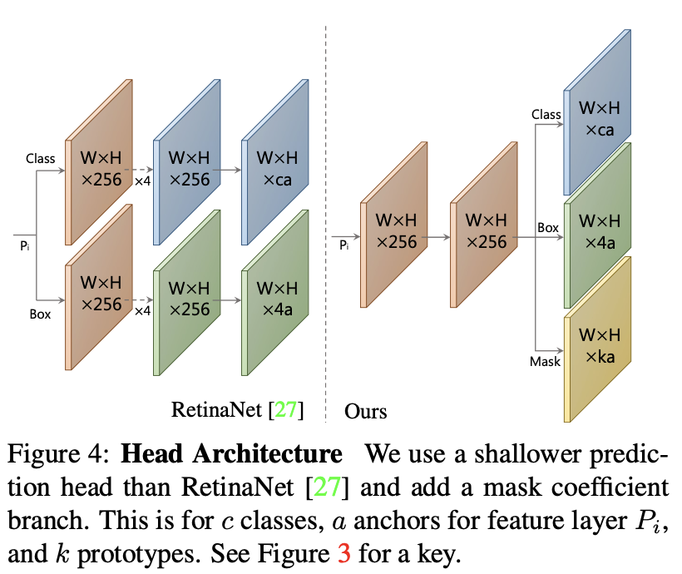
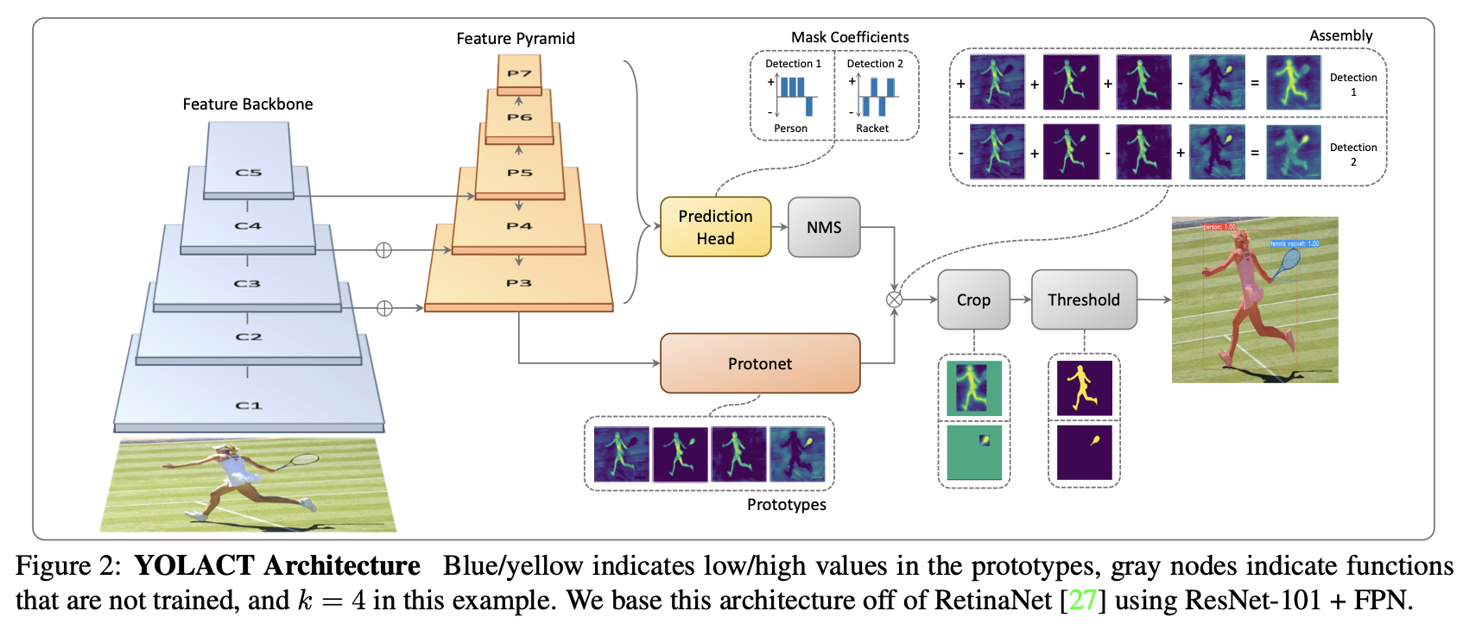
Instance Segmentation Task
YOLACT (2019)
https://arxiv.org/abs/1904.02689

Slide 77
Instance Segmentation Task
Datasets:
COCO (Common Objects in Context)
330,000 images
80 object categories
Instance-level annotations
https://cocodataset.org/
LVIS (Large Vocabulary Instance Segmentation)
1200 categories
Long-tailed distribution
High-quality instance annotations
https://www.lvisdataset.org/

Slide 78
Panoptic Segmentation Task
Panoptic segmentation: each pixel in a scene is assigned a semantic label and a unique instance identifier
Combines semantic and instance segmentation
CNN approaches:
Panoptic FPN (2019)
UPSNet (Unified Panoptic Segmentation Network) (2019)

Slide 79
Panoptic Segmentation Task
Panoptic FPN (2019)
Key Innovations:
Unified architecture for both things (instance) and stuff (semantic)
Shared backbone for efficiency
Better handling of overlapping instances
Architecture:
FPN (Feature Pyramid Network) backbone
Semantic segmentation branch
Instance segmentation branch
Training: uses panoptic quality metric
https://arxiv.org/abs/1901.02446

Slide 80
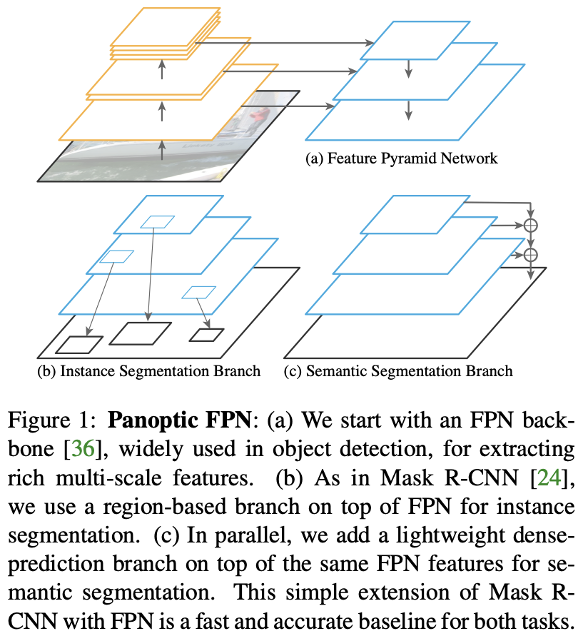
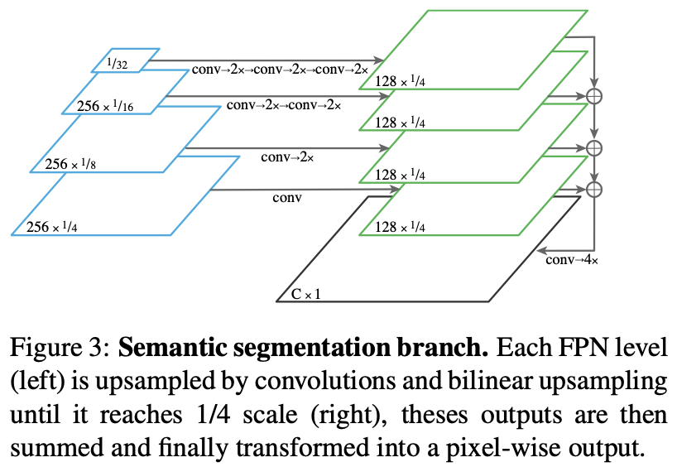
Panoptic Segmentation Task
Panoptic FPN (2019)
https://arxiv.org/abs/1901.02446

Slide 81
Panoptic Segmentation Task
UPSNet (Unified Panoptic Segmentation Network) (2019)
Key Innovations:
Better handling of overlapping regions
Improved instance segmentation
Architecture:
Shared feature extractor
Semantic head
Instance head
Panoptic head
Training: Uses panoptic segmentation loss
https://arxiv.org/abs/1901.03784

Slide 82
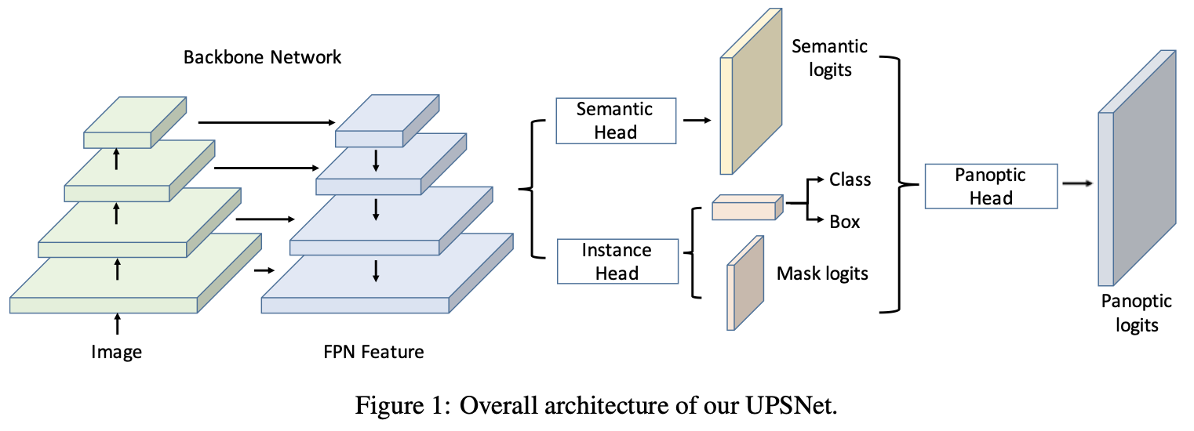
Panoptic Segmentation Task
UPSNet (Unified Panoptic Segmentation Network) (2019)
https://arxiv.org/abs/1901.03784

Slide 83
Panoptic Segmentation Task
Datasets:
COCO Panoptic
Extension of COCO dataset
Panoptic annotations
Both things and stuff categories
https://cocodataset.org/#panoptic-2019
Mapillary Vistas
25,000 street-level images
124 object categories
Panoptic annotations
https://www.mapillary.com/dataset/vistas

